Slide 1
Exploratory Data Analysis using SAS Project 3
BINF 5210 E-001
Dr Riddhi Vyas
Ajith Kumar Kannan

Slide 2
Project Objective
To determine whether "Drug A" helps to reduce fasting sugar levels.
Study Design:
Participants: 3400 patients
Groups: Low-Drug A, High-Drug A, Placebo
Sites: Three study centers
Outcome: Test scores (after 10 weeks)

Slide 3
Data Loading and Preparation
Initial Data:
Initial_Study with variables: PatientID, Age, State ($), Length_of_Stay, Total_Charge.
Second_Study with variables: PatientID, Site ($), Group ($), Test_Score.
Converted Xlsx file to txt and loaded the data by creating a permanent library called “K1”.
Data loading and merging Steps:
Assigned variable names.
Datasets merged using PatientID as the key.
Checked for missing values and invalid entries using SAS conditional processing.
Deleted observations with issues.

Slide 4
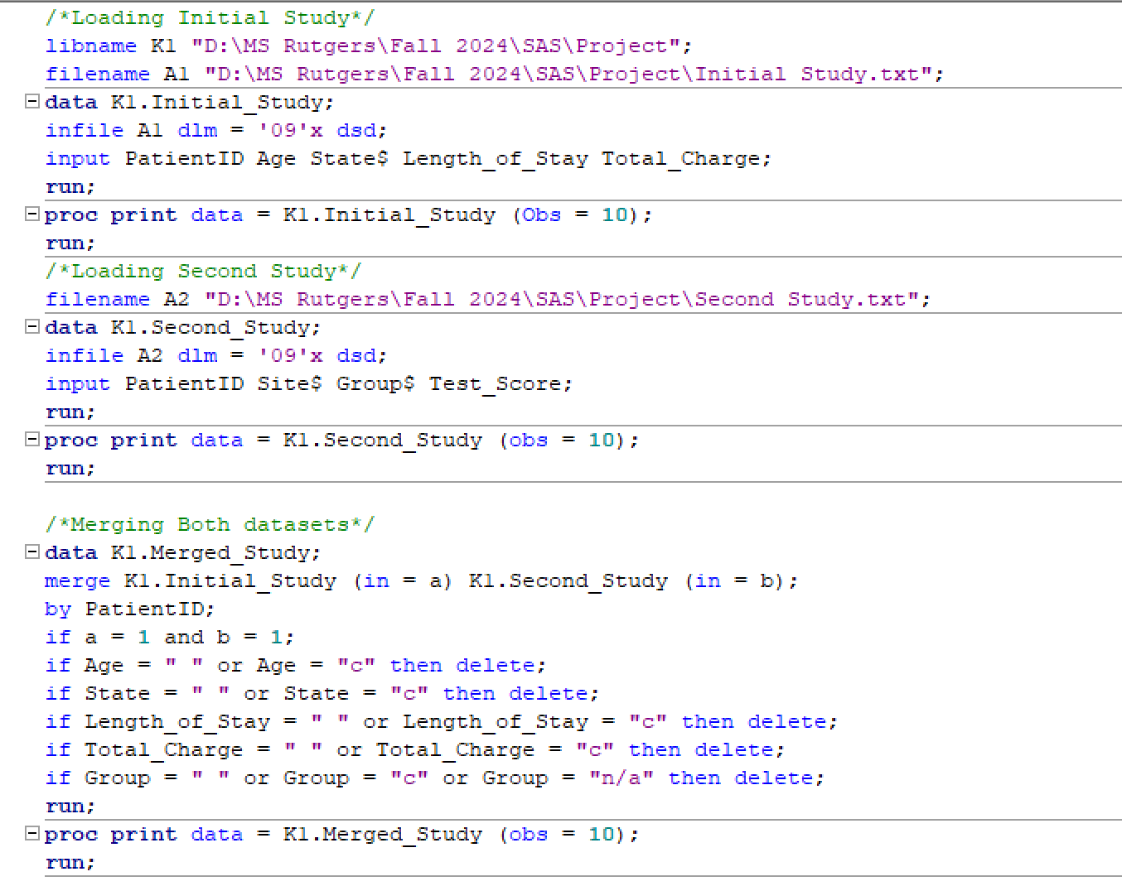
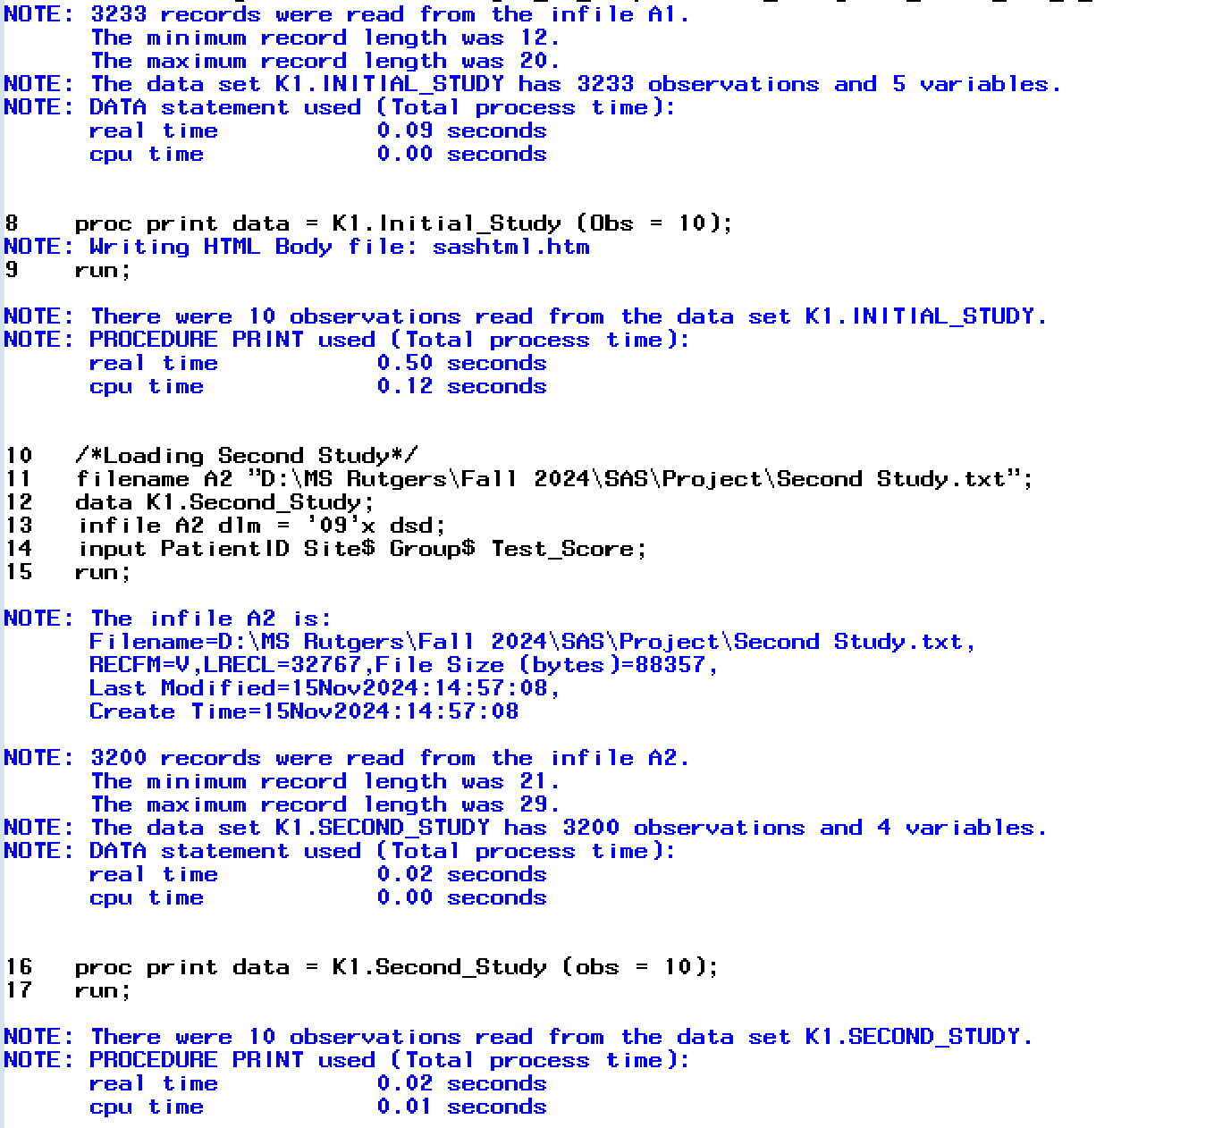
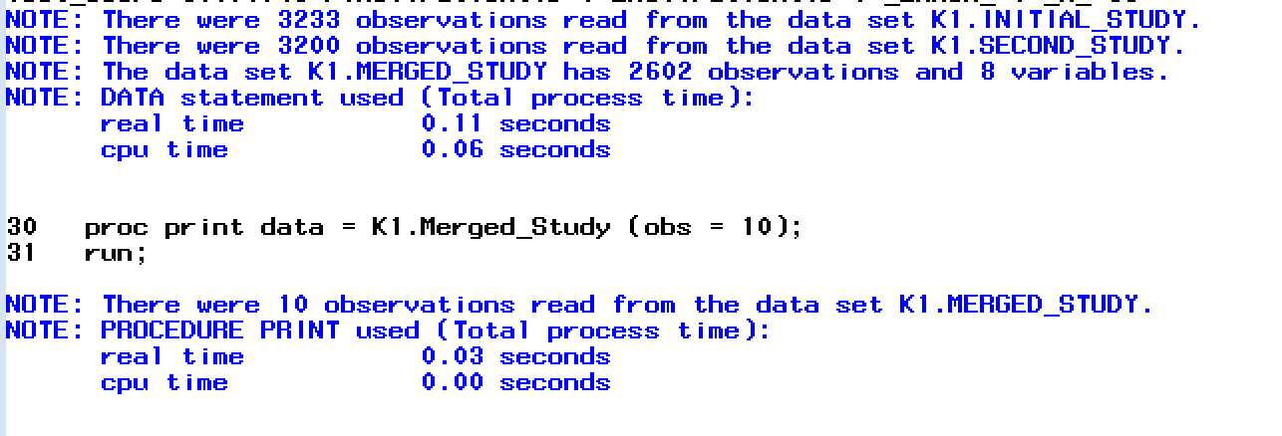

Slide 5
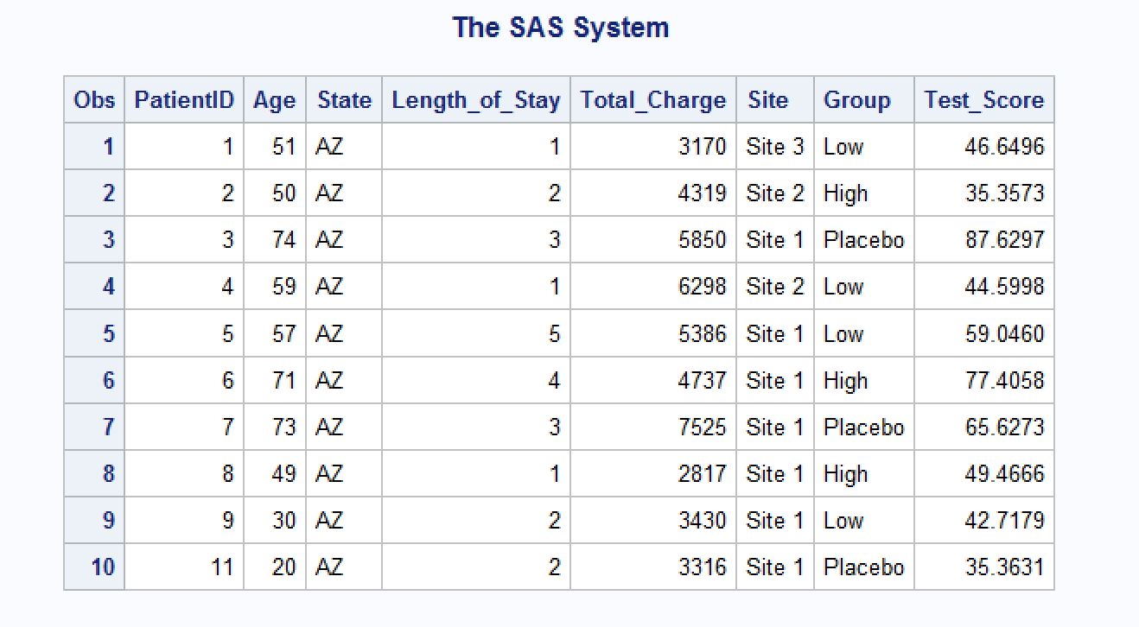
Final Dataset
Final dataset called K1.Merged_Study contains variables: PatientID, Age, State, Length_of_Stay, Total_Charge, Site, Group, Test_Score.
Verified merge using PROC PRINT to check the first 10 rows.

Slide 6
Sampling Using SRS
Method: Simple Random Sampling (SRS)
Sample Size: 1000 observations
Procedure: Used PROC SURVEYSELECT in SAS without a seed value.
Final Dataset: K1.Sample_Study

Slide 7
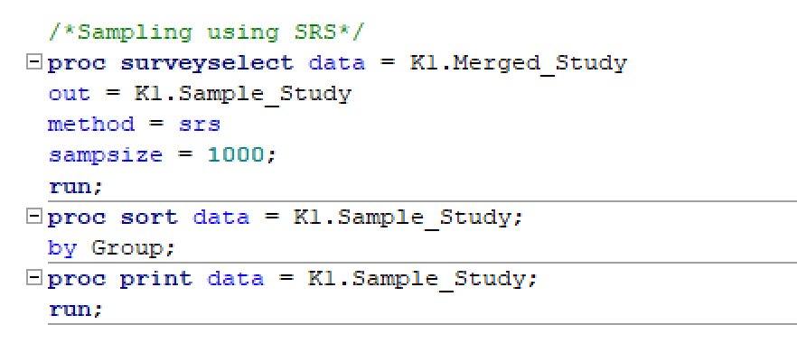
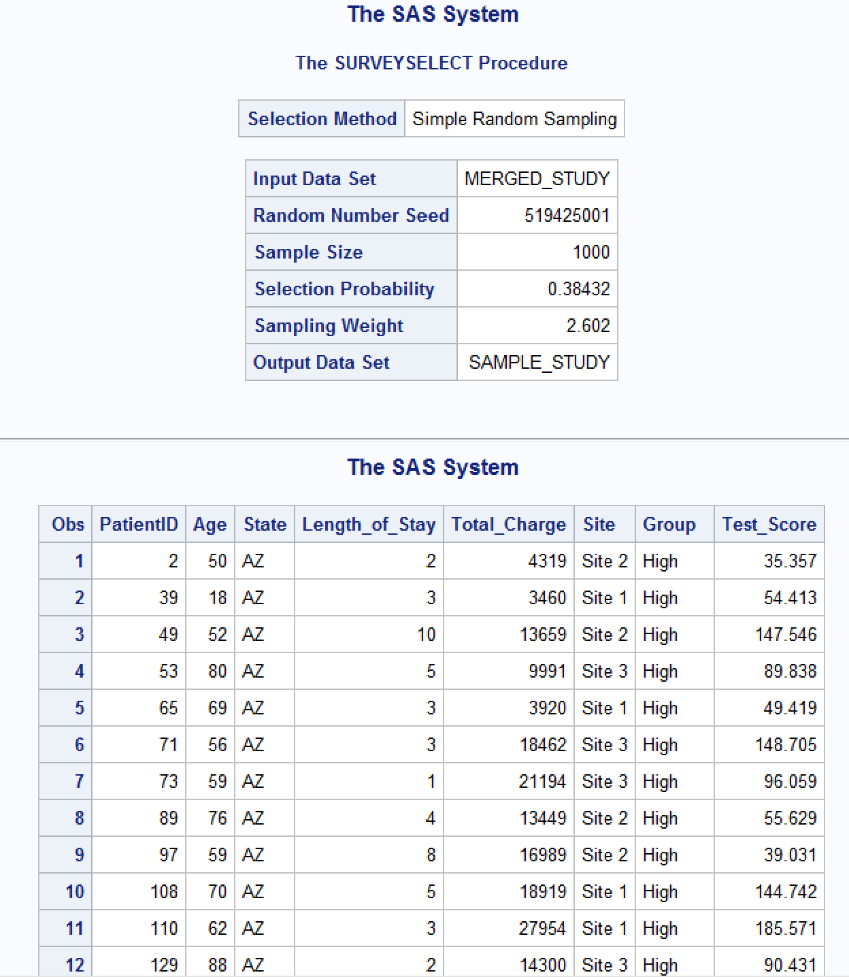
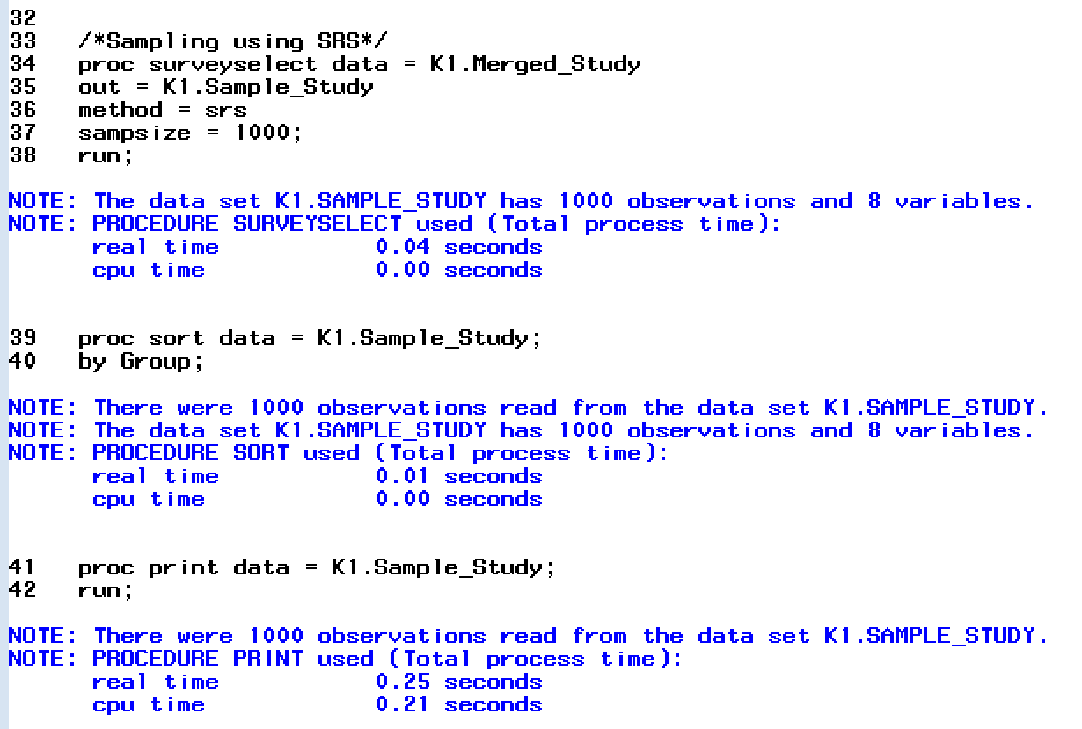

Slide 8
Descriptive Statistics
Descriptive statistics for numeric variable Test_Score by Group and Site.
Used PROC UNIVARIATE for summary statistics and normality check.
Shapiro Wilk P-value for all test groups (High, Low, and Placebo) and Sites were < 0.0001 (Distribution is not normal).
Skewed distribution was seen on the histogram for the groups and different sites.

Slide 9
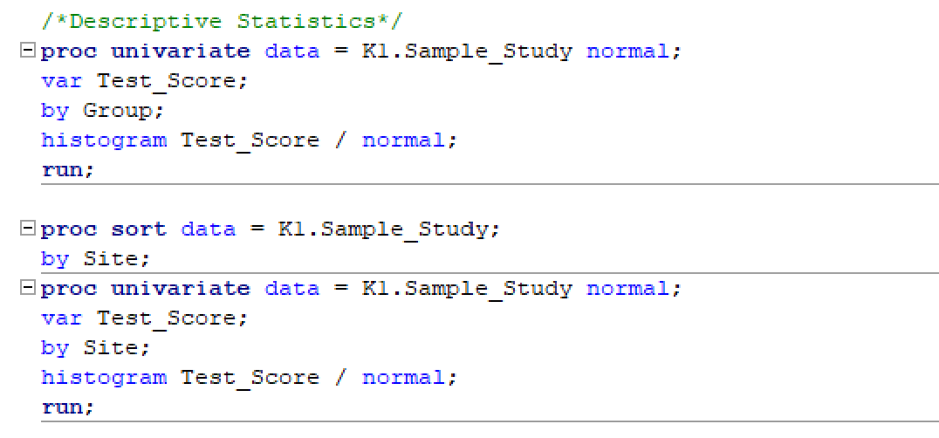
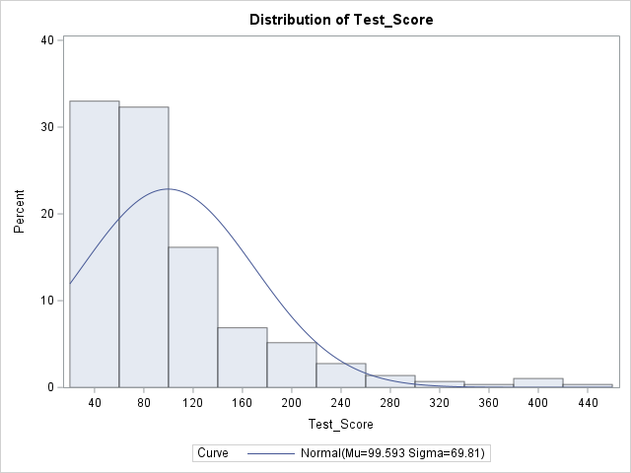
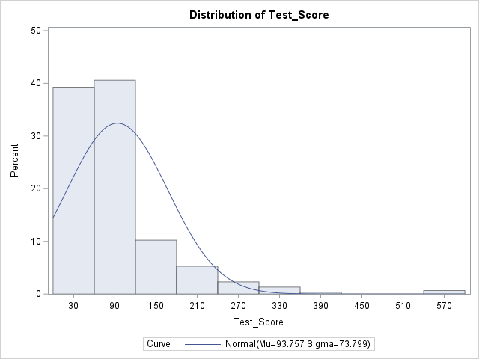
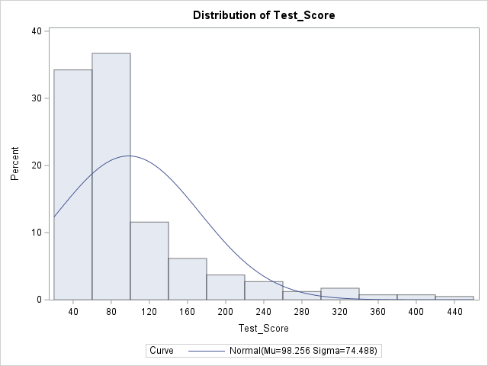
High Group
Low Group
Placebo Group

Slide 10
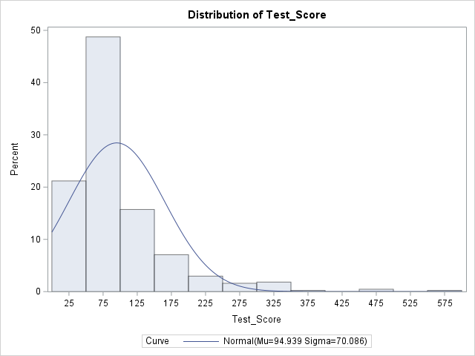
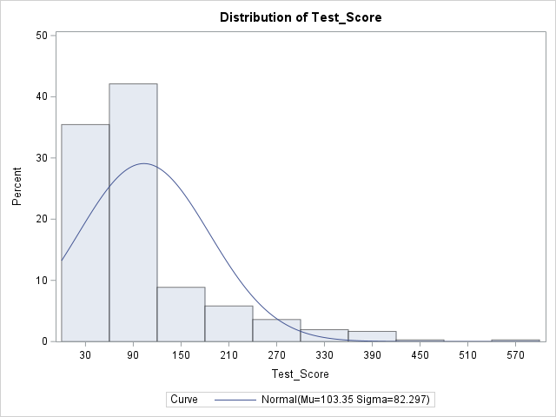
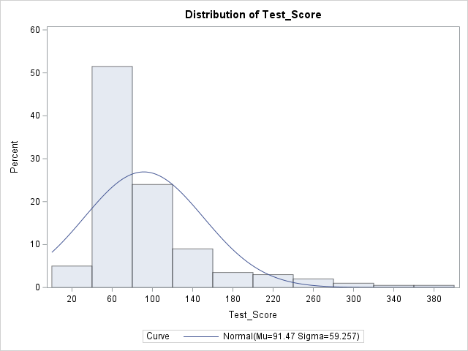
Site 1
Site 2
Site 3

Slide 11
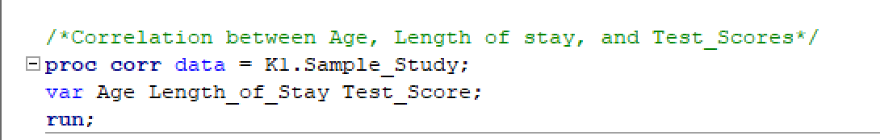
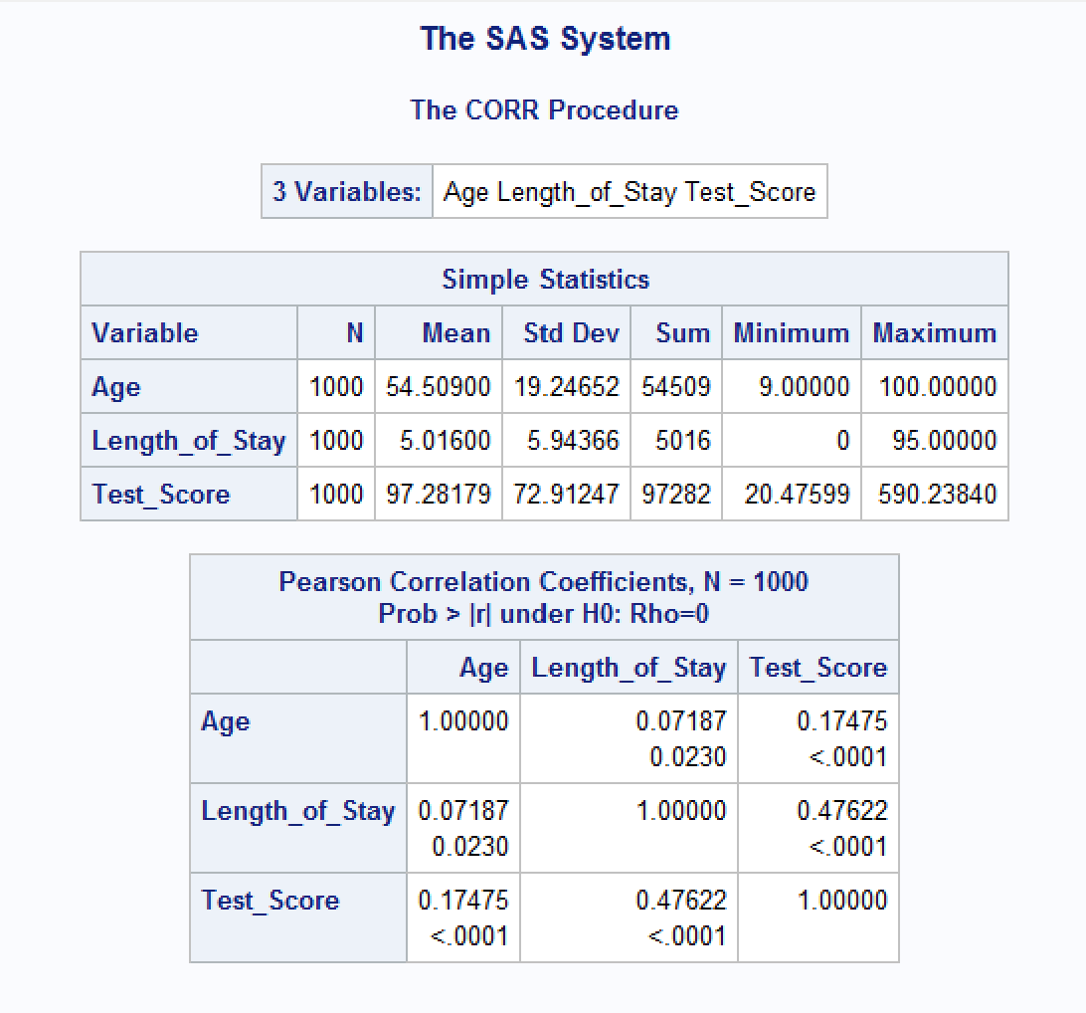
Correlation
To check the relationship between Age, Length_of_Stay, and Test_Score.
A positive correlation was seen between
Age and Test_Score (0.175)
Length_of_Stay and Test_Score (0.476)

Slide 12
Research Hypothesis
Null Hypothesis (H₀): There is no significant difference in Test_Scores between treatment groups (Low, High, Placebo).
Alternative Hypothesis (H₁): There is a significant difference in Test_Scores between treatment groups.

Slide 13
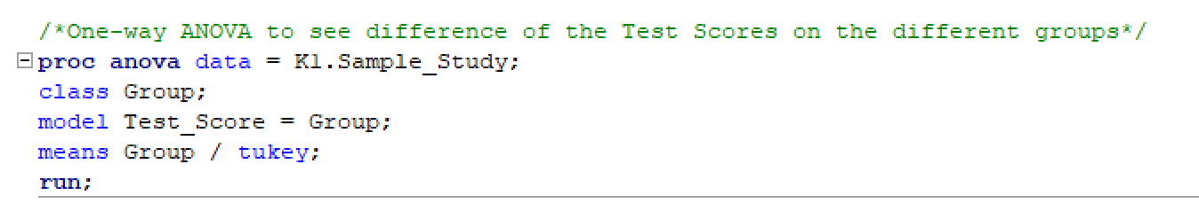
One-Way ANOVA
Purpose: To compare Test_Scores across treatment groups.
Method: PROC ANOVA to conduct ANOVA.
Checked assumptions: Assumed the data was normal and homogeneity of variance is satisfied although it is not (based on descriptives).

Slide 14
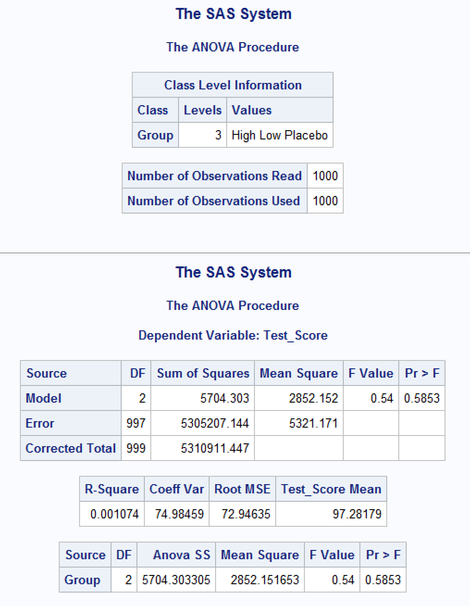
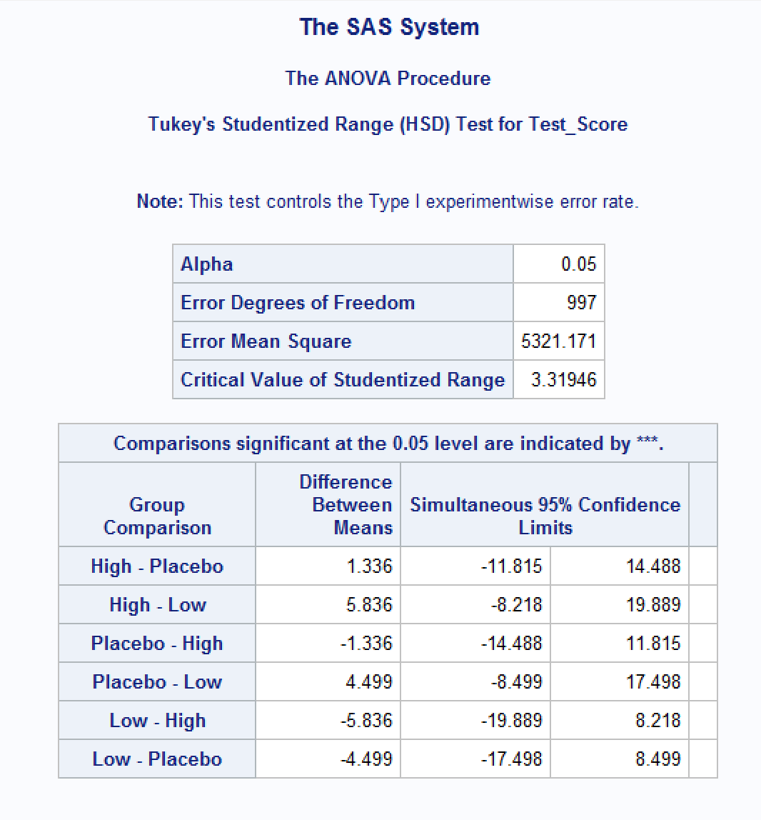

Slide 15
Results
R-Square = 0.001074, indicating a very low proportion of variation in Test_Score explained by the treatment groups.
F-Value = 0.54, with Pr > F = 0.5853, which is greater than 0.05.
Therefore, we conclude that there is no significant difference in Test_Scores between treatment groups (Low Drug A, High Drug A, and Placebo) after taking Drug A.

Slide 16
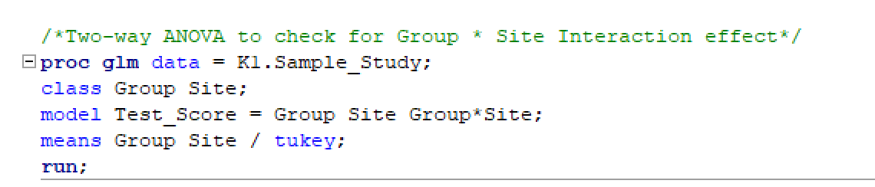
Two-Way ANOVA
Purpose: To test interaction effects of Group and Site on Test_Score.
Method: PROC GLM with interaction term (Group*Site).
Checked assumptions: Normality, homogeneity of variances.

Slide 17
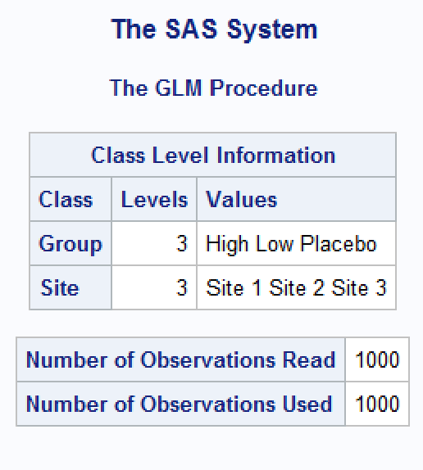
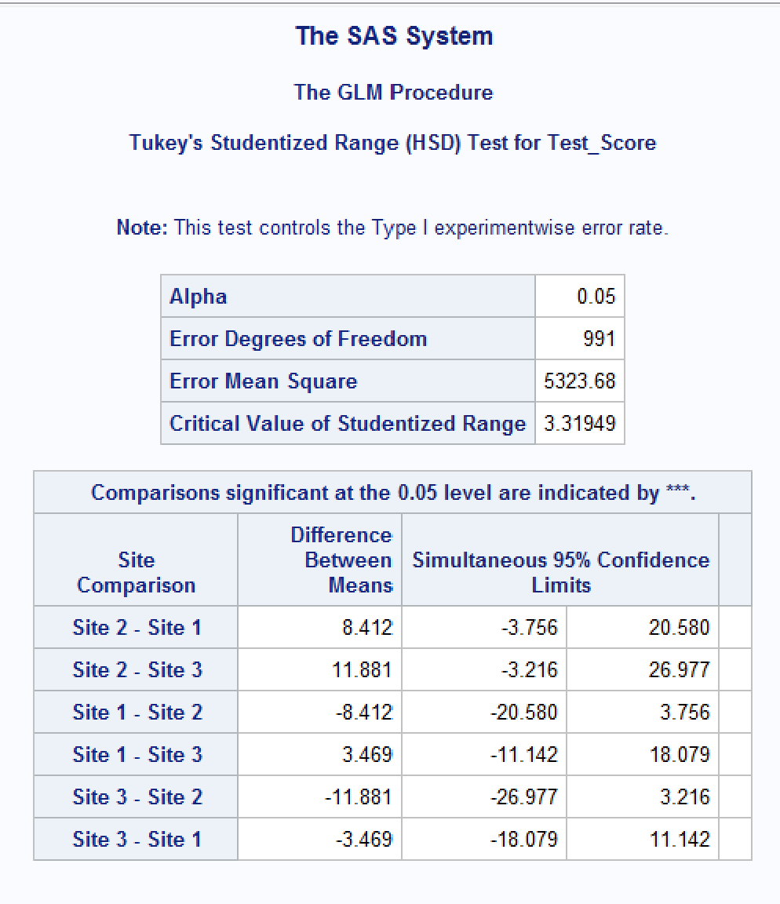
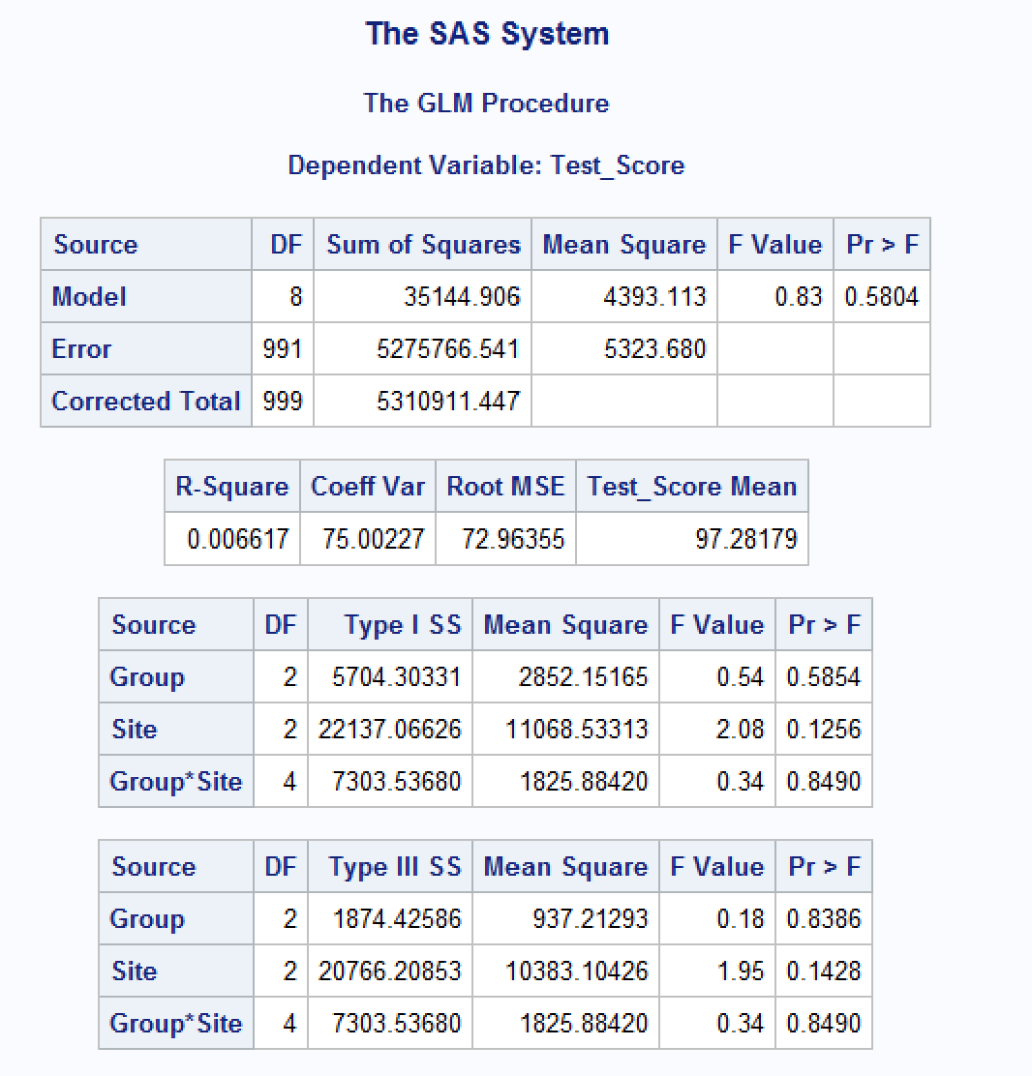

Slide 18
Results (Type III)
Since we are analyzing both main effects (Group, Site) and their interaction (Group*Site), Type III Sum of Squares is more appropriate. It adjusts for all other terms in the model and provides results that are not dependent on the order of entry.
Main Effect of Group:
F = 0.18, p = 0.8386
Interpretation: No significant effect of treatment groups on Test_Score.
Main Effect of Site:
F = 1.95, p = 0.1428
Interpretation: No significant effect of site on Test_Score.
Interaction Effect (Group*Site):
F = 0.34, p = 0.8490
Interpretation: No significant interaction between the Groups and the Site.
These results suggest that Drug A may not significantly impact fasting sugar levels regardless of the treatment dose or location (Site).

Slide 19
THANK YOU

